Slide 1
Big mountain: ticket pricing and facilities
Sahar Manavi – January 2021

Slide 2
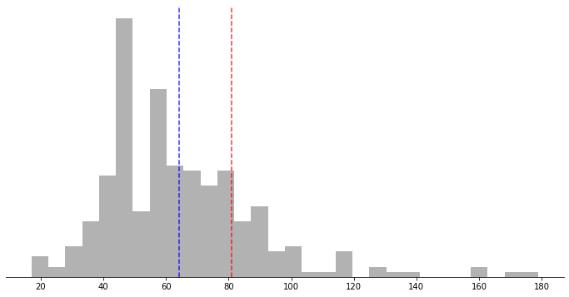
Currently We set our ticket prices to be slightly above the market average.
Ticket price distributions for resorts in market share
Big Mountain
Average
Adult weekend ticket price ($)

Slide 3
However, we are much more than “slightly” above Average
Where Big Mountain ranks:
Skiable terrain area: 98th percentile
Snow making area: 97th percentile
Longest run: 96th percentile
Number of lifts: 94th percentile
Number of fast quad lifts: 93rd percentile
Vertical drop: 90th percentile

Slide 4
How can we better leverage our top tier resort?
3 options based on what we would like to do with our facilities:
Reduce
Close one run without a reduction in ticket price.
Close up to 5 runs with approx. reduction in ticket price of $0.70.
Increase
Add one run and lift, increasing our vertical drop, for ticket price increase of $1.99.
Consider instead making new lift a fast quad for potential ticket price increase of $23.87.
No change
We are under-charging for our current facilities.
Even changing nothing, we can increase ticket price by almost $15.00.

Slide 5
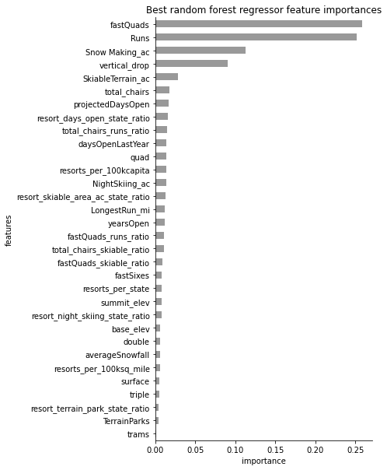
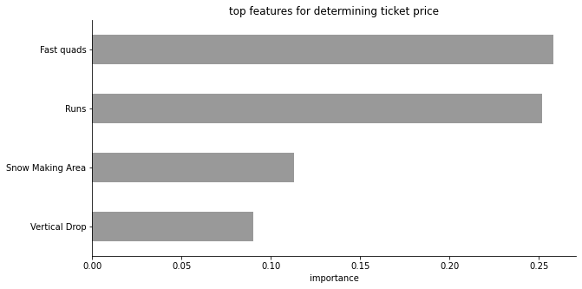
There are four key features
Our model found 4 features across all resorts that had the largest impact on ticket price. This suggests these are the features that customers are most willing to pay more for.

Slide 6
Scenario 1: reducing runs

Slide 7
Scenario 2: adding a run and lift

Slide 8
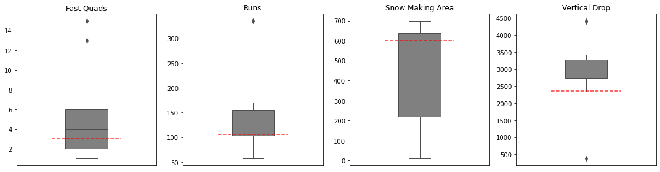
How does Big mountain compare to other high-ranking resorts in these categories?

Slide 9
Conclusions
We can increase our ticket price for this coming season without making any changes whatsoever.
We have options to either increase or decrease the number of features and facilities we have available, to either reduce operation costs or increase revenue through ticket sales.
For any options requiring changes to facilities, further analysis will need to be done that takes operation cost changes into account to get a more accurate picture of revenue changes.

